Slide 1


Slide 2

Swiggy Health Bites: A Holistic Marketing Plan
This presentation will explore a comprehensive marketing plan for Swiggy's new product line, Swiggy Health Bites, designed to cater to the growing health-conscious consumer market in India. The plan leverages Swiggy's brand equity, strong delivery network, and digital expertise to position Health Bites as a leading choice for healthy and convenient meals.

Slide 3
Product Overview: Swiggy Health Bites
Addressing a Market Need
Targeting a Specific Demographic
The increasing demand for healthy and convenient food options aligns perfectly with Swiggy's existing platform. Swiggy Health Bites aims to capitalize on this trend by providing a curated selection of nutritious meals delivered directly to customers' doorsteps.
Swiggy Health Bites targets health-conscious individuals, busy professionals, fitness enthusiasts, and families seeking nutritious meal options without the hassle of cooking.

Slide 4
Research and Development Phase
1
Market Research
2
Market Size and Growth Potential
Swiggy conducted thorough market research, analyzing the Indian food delivery landscape, identifying the growth of the health and wellness trend, and understanding the needs and preferences of the target market.
The health-focused food market in India is experiencing rapid growth, with a projected CAGR of over 10%. Swiggy Health Bites is well-positioned to capitalize on this growing market and contribute significantly to Swiggy's revenue.
3
Competitor Research
4
SWOT Analysis
Swiggy analyzed key competitors such as Zomato Health, EatFit, FreshMenu, and local health cafes to understand their strengths and weaknesses, and identify opportunities for differentiation.
Swiggy conducted a SWOT analysis to identify its strengths, weaknesses, opportunities, and threats, providing valuable insights for developing a strategic marketing plan.

Slide 5
Pricing Strategy: Balancing Affordability and Premium Positioning
Value-Based Pricing
Penetration Pricing
Swiggy Health Bites pricing will reflect the value of its health-focused meals, catering to customers who prioritize quality ingredients and preparation.
Swiggy might implement penetration pricing initially to gain market share and build awareness. Offering lower prices could attract customers who are hesitant to spend more on healthy options.
Tiered Pricing
Bundle Pricing
Swiggy Health Bites might introduce tiered pricing with different levels of health benefits, catering to various budgets. For example, basic meals could include salads, while premium options could include keto or gluten-free meals.
Swiggy can offer bundle pricing with discounted rates for sets of meals, such as breakfast, lunch, and snacks. Subscription plans could incentivize long-term commitment and customer loyalty.

Slide 6
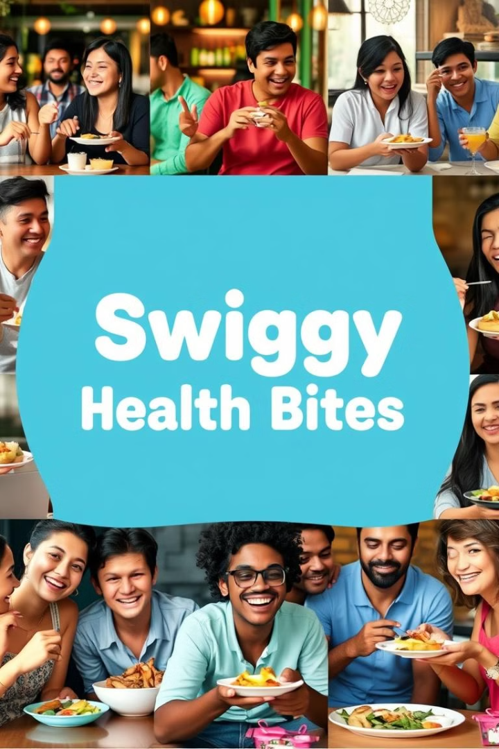



Promotional Tactics: Leveraging Swiggy's Brand Equity
Branding and Positioning
Swiggy Health Bites will be positioned as a premium yet affordable solution for those seeking healthy and delicious meals delivered to their doorstep.
Digital Marketing
Leveraging influencers, social media campaigns, and email marketing will engage the target audience and create awareness about Swiggy Health Bites.
Collaborations and Partnerships
Swiggy will collaborate with gyms, fitness centers, and wellness platforms to expand its reach and promote Health Bites to a wider audience.

Slide 7
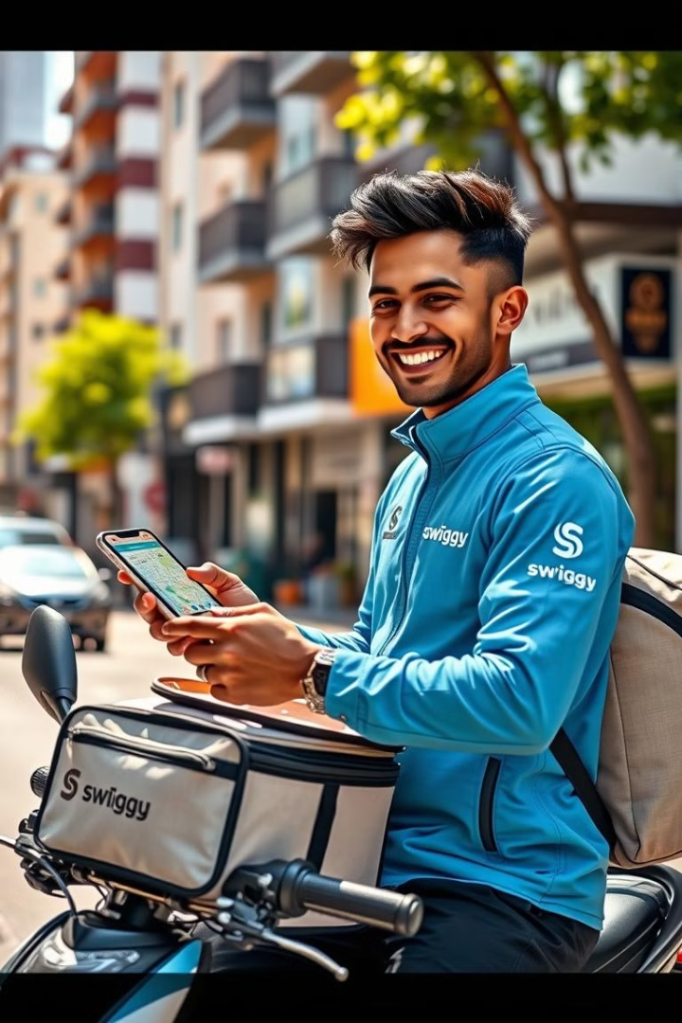
Distribution Strategy: Optimizing Delivery and Packaging
1
Platform Accessibility
Swiggy Health Bites will be exclusively available through Swiggy's mobile app and website, providing seamless access to the product line.
2
Demographic Focus
Swiggy will initially focus on millennials and Generation Z, who prioritize fresh, healthy, and sustainable options.
3
Delivery and Packaging
Swiggy will use its existing delivery network to ensure timely and efficient delivery of Health Bites meals. Sustainable and eco-friendly packaging with clear nutritional information will contribute to a premium experience.

Slide 8



Customer Experience and Feedback: Building Loyalty
Customer Support
A dedicated health and wellness customer support team will address dietary concerns and provide personalized meal plan customization.
Loyalty Program
Swiggy will introduce a loyalty program where users can earn points for purchasing Health Bites, which can be redeemed for discounts on future orders.

Slide 9
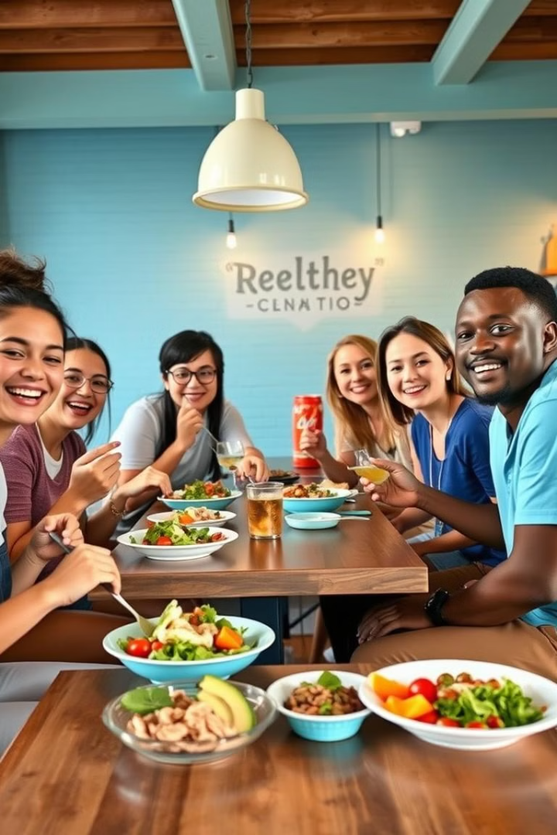
Conclusion: Expanding Swiggy's Reach in the Health and Wellness Space
Swiggy Health Bites will not only help Swiggy enter the growing health and wellness space but also cater to the rising demand for healthier, convenient eating options. By focusing on customer experience, innovation, and strategic promotions, Swiggy can drive growth, customer loyalty, and increased revenue in this rapidly expanding market segment.

